Slide 1
Data Warehouse Project
Talend Tech Solutions

Slide 2
Agenda
Project Overview
Architecture
Data Dictionary
Data Flows
Conclusion
Talend Tech Solutions

Slide 3
Project Overview
Introduction:
The Data Harbor Organization aims to enable Data-driven decision-making in their retail domain by implementing a comprehensive data integration and analysis solution.
The primary focus is to embrace a data-driven approach to steer their business forward that bridges the gap between raw data and actionable insights.
Unlike other domains like Healthcare, Banking, and Education, the retail industry represented by DATAHARBOR, requires in-depth analysis of sales data.
A Data Warehouse is essential to consolidate and transform this data for effective business analytics, allowing DATAHARBOR organization to make informed decisions.
The project embraces Online Analytical Processing (OLAP) and the concept of a Data Warehouse.
Star schema is used to enable seamless data retrieval for meaningful insights.
Talend Tech Solutions

Slide 4
2.Scope
Understanding Yearly Sales: DATAHARBOR seeks an extensive view of its yearly sales, both as a collective entity and a granular analysis by each store.
Identifying Top-Performing Stores: The project aims to pinpoint the store that boasts the highest sales performance, furnishing DATAHARBOR with vital operational insights.
Identifying Top-Performing Sales Person : By determining the best salesperson across each store and the entire organization, DATAHARBOR organization can recognize and reward excellence.
Determine Reliable Suppliers: Accurate supplier identification supports DATAHARBOR in maintaining reliable partnerships.
Product Insights: From the best-selling product to least selling, DATAHARBOR needs a comprehensive product analysis.
Talend Tech Solutions

Slide 5
Architecture and Design
The architecture and design of the DATA HARBOR Retail Data Warehouse Integration Project encompass a systematic blueprint that is specific to business requirements and facilitate efficient data processing, storage and analysis.
Data Sources and Extraction
The project's architecture initiates with data extraction from diverse sources that constitute DATA HARBOR's retail ecosystem. These sources encompass Employee, Sales, Store, and Supplier databases, residing on the AWS S3 cloud storage platform. AWS S3 serves as a reliable repository maintaining raw data ready for integration and analysis.
Talend Tech Solutions

Slide 6

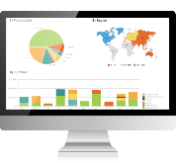

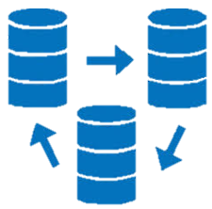



Design
Data Consumption
S3
Snowflake
Data Storage
Data Processing
Staging Area
Analytics Data Layer
5 files
Internal Files
Amazon S3
BI Dashboards
ETL Integrations
Reporting Integration
Talend Tech Solutions

Slide 7
Data Transformation and Cleansing
The extracted undergoes data transformation and cleansing involving the below steps:
Removal of duplicate records to ensure data integrity.
Schema validation to align with the predefined data structure.
Handling of null values and anomalies
ETL Processes and Talend
The transformation process is completed through Extract, Transform, Load (ETL) procedures. Talend, a robust ETL tool acts as a prominent stage, providing a versatile environment for implementing complex transformations and orchestrating the flow of data. Talend's capabilities allow DATAHARBOR organization to maintain data according to their specific business requirements.
Talend Tech Solutions

Slide 8
Data Storage and Snowflake Database
Following transformation, the refined data is placed in the Snowflake database which is chosen for its scalability, performance, and built-in capabilities for handling structured and semi-structured data. The Snowflake database, residing in the cloud, ensures efficient storage and seamless accessibility.
Star Schema for Analysis
The project employs a star schema design to facilitate efficient data analysis. Within this schema: Dimension tables (Employee, Store, Supplier) offer context and attributes for slicing and dicing data. The fact table (Sales) serves as the central repository of quantitative data.
Talend Tech Solutions

Slide 9
Agile Methodology and Jira Implementation
The project management approach is well balanced in Agile methodology fostering collaboration, adaptability and iterative development. Jira, a versatile project management tool, empowers DATA HARBOR to plan, track, and manage project activities ensuring alignment with Agile principles.
Error Handling And Monitoring
To ensure transparency and reliability, robust error handling and monitoring mechanisms are integrated. This includes:
Email notifications through Talend to communicate job execution status (success or failure).
Logging components within Talend to maintain a detailed record of job status and relevant information.
Talend Tech Solutions

Slide 10
Data Dictionary
The Data Dictionary outlines the key data entities, attributes and definitions involved in the DATA HARBOR Retail Data Warehouse Integration Project. This dictionary provides a comprehensive reference for understanding the data elements used in the project.
Dimension Table Relationships
Sales to Employee
Foreign Key: employee_id in Sales Table
Referenced Table: Employee Table
Talend Tech Solutions

Slide 11
Sales to Store
Foreign Key: store_id in Sales Table
Referenced Table: Store Table
Sales to Product
Foreign Key: product_id in Sales Table
Referenced Table: Product Table
Fact Table
Fact Table Name: Sales
Measures: quantity_sold, sales_amount
Foreign Keys: employee_id, store_id, product_id
Aggregated Data: Enables analysis of sales performance based on employees, stores, and products.
Talend Tech Solutions

Slide 12
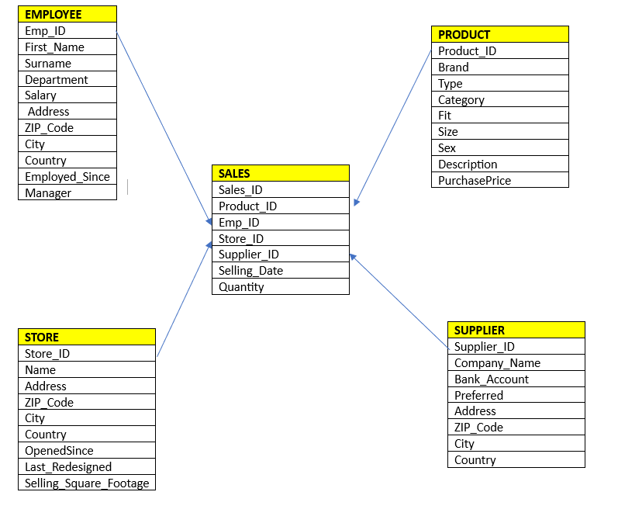
STAR SCHEMA
Talend Tech Solutions

Slide 13
Data Flows
Data Extraction and Source Location (AWS S3)
Data Sources: The project sources data from Employee, Sales, Store, and Supplier databases.
Source Location: Data is extracted from these databases stored in AWS S3, a cloud storage platform.
Staging Area and Data Cleaning
Staging Area: Extracted data is loaded into a staging area for preparatory steps.
Data Cleaning: Within the staging area, data undergoes cleansing processes:
Duplicate records are removed to ensure data integrity.
Schema validation is performed to verify data structure consistency.
Handling of null values and anomalies enhances data quality.
Talend Tech Solutions

Slide 14
Transformations Using Talend
Talend Transformations: The Talend ETL tool comes into play to implement critical data transformations tailored to DATAHARBOR's business requirements.
Data Alignment: Talend orchestrates transformations that align data with specific business rules and analytics needs.
Data Loading to Snowflake Database
Snowflake Database: The transformed data is loaded into the Snowflake database, chosen for its scalability and analytical capabilities.
Target Schemas: The Snowflake database comprises DataHarbor_staging, DataHarbor_target, and DataHarbor_logging schemas.
Talend Tech Solutions

Slide 15
Schema for Table DataHarbor_Employee
Column | Type
Emp_ID | int
First_Name | varchar
Surname | varchar
Department | varchar
Salary | int
Address | varchar
ZIP_Code | int
City | varchar
Country | varchar
Employed_Since | date
Manager | varchar
Talend Tech Solutions

Slide 16
Schema for Table DataHarbor_Product
Column | Type
Product_Id | int
Brand | varchar
Type | varchar
Category | varchar
Fit | varchar
Size | int
Sex | varchar
Description | varchar
PurchasePrice | int
Talend Tech Solutions

Slide 17
Schema for Table DataHarbor_Supplier
Column | Type
Supplier_ID | int
Company_Name | varchar
Bank_Account | numeric
Preferred | varchar
Address | varchar
ZIP_Code | int
City | varchar
Country | varchar
Talend Tech Solutions

Slide 18
Schema for Table DataHarbor_Store
Column | Type
Store_ID | int
Name | varchar
Address | varchar
ZIP_Code | int
City | varchar
Country | varchar
Opened_Since | int
Last_Redesigned | int
Selling_Square_Footage | int
Talend Tech Solutions

Slide 19
Schema for Table DataHarbor_Sales
Column | Type
Sales_ID | int
Customer_ID | int
Emp_ID | int
Store_ID | int
Product_ID | int
Selling_Date | timestamp
Quantity | int
Talend Tech Solutions

Slide 20
Schema for Table DataHarbor_Audit
Column | Type
execid | serial
id | int
jobname | varchar
status | varchar
startdate | timestamp
enddate | timestamp
source_count | int
target_count | int
reject_count | int
Talend Tech Solutions

Slide 21
Conclusion
The DATAHARBOR Retail Data Warehouse project revolves around establishing a data warehouse to facilitate effective business analytics. By leveraging the capabilities of OLAP, employing a star schema, adhering to Agile methodologies and utilizing tools like Talend and Jira, the DataHarbor project ensures that their retail sales data is transformed into actionable insights for informed decision-making.
The DataHarbor Project orchestrates a seamless series of data flows from source extraction to Snowflake database integration. Each step in the data flow contributes to the refinement and transformation of raw sales data into valuable insights aligning Data Harbor's business analytics needs with the power of data. In this exciting journey, technology, methodology, and innovation converge to shape Data Harbor's data-driven destiny.
Talend Tech Solutions

Slide 22
Thank you
Talend Tech Solutions

